Slide 1
NetworKING
CEO: Carter Kolwey
VP: Lillian Cash
AO: Tim Gibson
SR Engineer: Allen Rachal
Head Tech: Josh King
Website: https://cheapiesystems.com/networking/

Slide 2
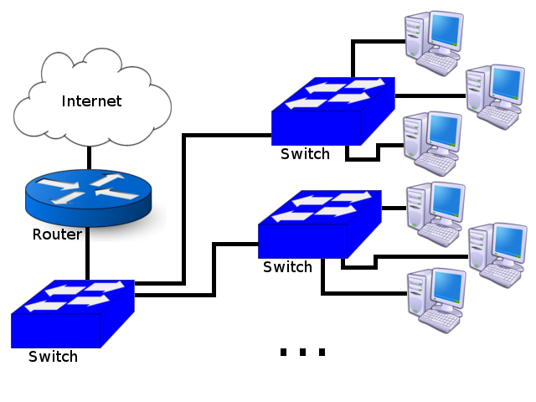
Laying it Out

Slide 3
Bronze Package $218.00
LevelOne FSW-0811 8-Port Switch ($19.99)
D-Link GO-SW-5G 5-Port Switch (6 at $14.99 each)
Ubiquiti ER-X EdgeRouter X 5-Port Broadband Router ($48.99)
500FT Cat5e Bulk Bare Copper Ethernet Cable ($44.99)
Wall Plate for Keystone, 1 Hole (6 at $0.44 each)
Slim Cat5E Punch Down Keystone Jack (6 at $1.25 each)
Delcast 100pcs RJ45 Modular Plug CAT5E Network Cable Connector ($3.95)

Slide 4
Silver Package $307.13
TP-LINK TL-SG1008D Unmanaged 8-Port Gigabit Desktop Switch (7 at $22.99 each)
TP-Link SafeStream TL-R600VPN Gigabit Broadband VPN Router ($52.99)
500FT Cat5e Bulk Bare Copper Ethernet Cable ($44.99)
Wall Plate for Keystone, 1 Hole (6 at $0.44 each)
Slim Cat5E Punch Down Keystone Jack (6 at $1.25 each)
Thomas & Betts BH122A-UPC Super Hard Body Wiring Box (6 at $3.63 each)
100 pcs Cat6, Cat5E Crimp Connectors Plug ($6.30)

Slide 5
Gold Package $576.28
NETGEAR ProSAFE 5-Port Gigabit Ethernet Switch (6 at $29.88 each)
Ubiquiti EdgeRouter ER-8 ($284.99)
500FT Cat6 Bulk Bare Copper Ethernet Cable ($54.99)
Wall Plate for Keystone (6 at $0.44 each)
Wall Plate for Keystone, 6 Hole ($0.44)
Slim Cat5E Punch Down Keystone Jack (12 at $1.25 each)
Thomas & Betts BH122A-UPC Super Hard Body Wiring Box (7 at $3.63 each)
100 pcs Cat6, Cat5E Crimp Connectors Plug 8P8C ($6.30)
uxcell® 100 Pcs Soft Plastic Ethernet RJ45 Cable Connector Boots ($7.23)

Slide 6
Platinum Package $10,533.24
CableRack 8 Port SFP Optical Switch (7 at $216.95 each)
TP-LINK TL-SM311LM Gigabit SFP module (48 at $29.13 each)
Cable Matters Multimode Fiber Patch Cable LC to LC – 20m (6 at $29.99 each)
Cable Matters Multimode Fiber Patch Cable LC to LC – 2m (18 at $12.99 each)
Addon Intel Based Single SFP Port PCIe Nic (18 at $29.20 each)
Cisco Small Business ISR4351-V/K9 Router ($6676.99)
Notes:
Carter

Slide 7
NetworKING
CEO: Carter Kolwey
VP: Lillian Cash
AO: Tim Gibson
SR Engineer: Allen Rachal
Head Tech: Josh King
Website: https://cheapiesystems.com/networking/

