Slide 1
Human Relations History
Lecture One

Slide 2
HUMAN RELATIONS
The composite of interactions that exist between people
in all aspects of
their personal
and professional lives.

Slide 3
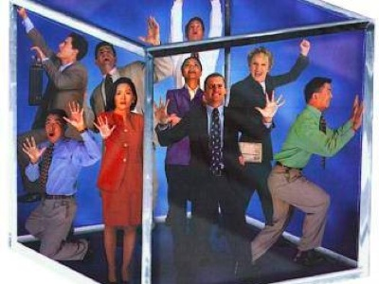
4 INTERPERSONAL SKILLS NEEDED
COMMUNICATION SKILLS
PROBLEM SOLVING TECHNIQUES
TEAM BUILDING & LEADING SKILLS
INITIATING & ADAPTING TO CHANGE

Slide 4
2 FACTORS THAT INFLUENCE WORK BEHAVIOR
PERSONAL CHARACTERISTICS
ORGANIZATIONAL CHARACTERISTICS
PERSONALITY
ATITUDE
VALUES
COMMUNICATION STYLE
GOALS
PEOPLE
STRUCTURE
CULTURE
JOB
SUPERVISION

Slide 5
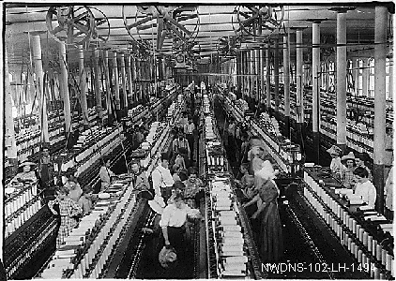
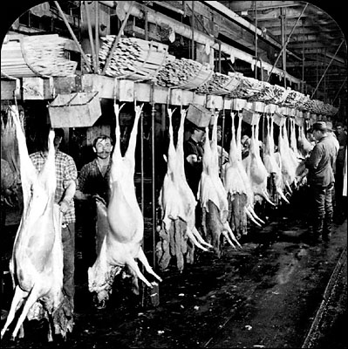
THE INDUSTRIAL REVOLUTION
From a Family Economy to a Surplus Economy!

Slide 6
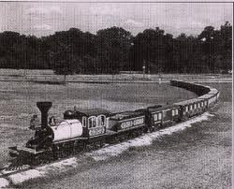
1865-1900 IN ONE GENERATION
Steel production increased 1,000 times
Railroads increased by 6 times their length
1850 9,000 miles
1865 35,000 miles
1900 200,000 miles
1920 407,000 miles
Farms tripled their production!
(407 million to 841 million acres)
U.S. Population: 1865 – 36 million
1920 - 102 million

Slide 7
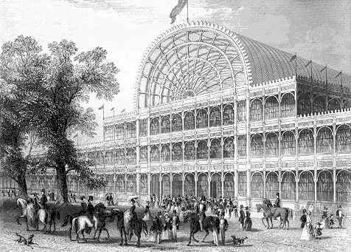
1851 Crystal palace World’s Fair
World’s Fair – Hyde Park, London
Notes:
The Crystal Palace was a cast-iron and plate-glass structure originally built in Hyde Park, London, to house the Great Exhibition of 1851. More than 14,000 exhibitors from around the world gathered in its 990,000-square-foot (92,000 m²) exhibition space to display examples of technology developed in the Industrial Revolution. Designed by Joseph Paxton, the Great Exhibition building was 1,851 feet (564 m) long, with an interior height of 128 feet (39 m).^{[1]} The invention of the cast plate glass method in 1848 made possible the production of large sheets of cheap but strong glass, and its use in the Crystal Palace created a structure with the greatest area of glass ever seen in a building and astonished visitors with its clear walls and ceilings that did not require interior lights.

Slide 8
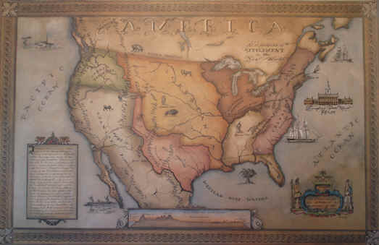
5 AMERICAN ADVANTAGES
Rich sparsely inhabited continent
Easy for US Government to buy or seize land
Highly literate population
Free movement of goods, people, capital & ideas
Coast to coast huge internal market

Slide 9
RESULTS OF THE AMERICAN INDUSTRIAL REVOLUTION
1850 20 millionaires
1900 3,000 millionaires
1860 9 American cities with population of 100,000+
1900 38 American cities with population of 100,000+
Inventions:
1867 Typewriter
1873 Barb Wire
1876 Telephone
1877 Phonograph
1879 Electric Lights
1885 Gasoline Automobile
1900 8,000 U. S. cars
1916 3,500,000 U. S. cars

Slide 10
Timeline of Change - Lab
The Civil War - Western Expansion
Industrial Revolution
WWI – WWII - Korean War
The Cold War
The Civil Rights Movement – Viet Nam
Space Age - Communication Age
Global Economy of Today

Slide 11
HUMAN RELATIONS MOVEMENT
20TH CENTURY ORGANIZATIONAL MOVEMENT CHARACTERIZED
BY THE BELIEF THAT
SATISFIED WORKERS WILL BE
PRODUCTIVE WORKERS!

Slide 12
1960’s Legislation
1963 Equal Pay Act
1964 Civil Rights Act, Title II (amended 1972)
1967 Age Discrimination in Employment Act
(Amended 1978)

Slide 13
1970’s Legislation
1973 Vocational Rehabilitation Act
1974 Privacy Act
1978 Mandatory Retirement Act
1978 Pregnancy Discrimination Act, Title VII

Slide 14
1980’s Legislation
1986 Immigration Reform and Control Act
1988 Polygraph Protection Act
1988 Worker Adjustment & Retraining Notification Act

Slide 15
1990’s Legislation
1990 Americans with Disabilities Act
1991 Civil Rights Act reaffirmed original Act and permitted lawsuits when discrimination could be proven to be intentional.
1993 Family and Medical Leave Act (FMLA)

Slide 16
12 KEY LEADERS IN THE HR MOVEMENT
Frederick Taylor
Frank & Lillian Gilbreth
Henry Gannt
Henry Fayol
Max Weber
Hugo Munsterberg
Mary Parker Follet
Chester Barnard
Elton Mayo
Dale Carnegie
Abraham Maslow
Douglas McGregor

Slide 17
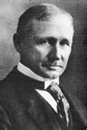
FREDERICK TAYLOR Father of Scientific Management
“SCIENTIFIC MANAGEMENT” – 1911
A set of principles that were designed to make:
Employees more productive
Providing greater profits for the organization
Shared with employees
The book Principles of Scientific Management, described how the application of the scientific method to the management of workers could greatly improve productivity.

Slide 18
TAYLOR’S 1911 PRINCIPLES OF MANAGEMENT
DEVELOP AN EXACT METHOD FOR PERFORMING EACH ELEMENT OF AN EMPLOYEE’S JOB
PROPERLY MATCH INDIVIDUALS TO THE JOB AND TRAIN THEM TO DO JOB THE BEST WAY
COOPERATE WITH EMPLOYEES TO ENSURE ALL WORK DONE ACCORDING TO EXACT METHODS
DIVIDE WORK RESPONSIBILY, ALMOST EQUALLY BETWEEN OWNERS AND WORKERS

Slide 19
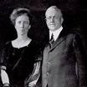
FRANK & LILLIAN GILBRETH
Consultants with 2 purposes: 1920’s
1. Increase the efficiency of workers
2. Reduce fatigue of work done
“THERBLIGS”
18 HANDMOTIONS

Slide 20
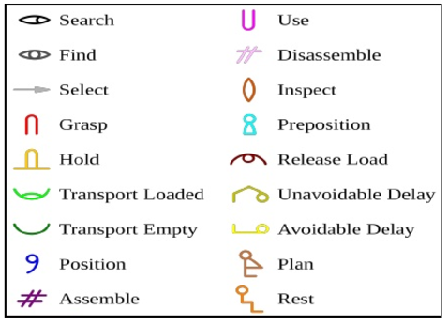
THERBLIGS - A basic motion element is one of a set of fundamental motions required for a worker to perform a manual operation or task. The set consists of 18 elements, each describing a standardized activity.

Slide 21
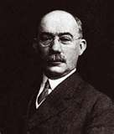
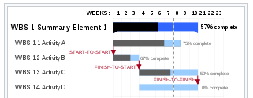
HENRY GANNT
GANNT CHART
VISUAL CHART USED FOR SCHEDULING 1910
Work scheduled Set Deadline Completion
Write Handbook April 28 April 26

Slide 22
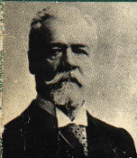
HENRY FAYOL - 1916
14 PRINCIPLES
OF MANAGEMENT
DIVISION OF WORK
AUTHORITY
DISCIPLINE
UNITY OF COMMAND
UNITY OF DIRECTION
SUBORDINATION OF INDIVIDUAL INTERESTS TO THE GENERAL INTEREST
REMUNERATION
CENTRALIZATION
SCALAR CHAIN
ORDER
EQUITY
STABILITY OF TENURE OF PERSONNEL
INITIATIVE
ESPRIT DE CORPS

Slide 23
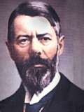
MAX WEBER
BUREAUCRACY –
Organizational structure that analyzes jobs according to simple, routine, well-defined tasks
Bureaucracies are: Impersonal & Inflexible

Slide 24
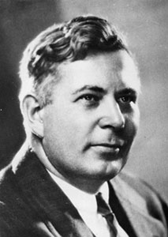
HUGO MUNSTERBERG
Psychological Tests
Match the Employees to the Work = Leads to a Motivated Workers

Slide 25
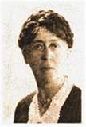
MARY PARKER FOLLET
INTRODUCED SELF-GOVERNING TEAMS
1918 THEORY
“Bureaucratic institutions should be replaced by group networks in which people themselves analyze their problems, and plan and implement solutions… The manager’s job is to coordinate group efforts.”

Slide 26
MARY PARKER FOLLET QUOTES
ORGANIZATION
“I have left to last what seems to me the chief function the real service, of business: to give an opportunity for individual development through the better organization of human relationships.”
LEADERSHIP
“The leader is the one who can organize the experience of the group…and thus get the full power of the group.
The leader makes the team…Men with this ability create group power rather than express a personal power.”

Slide 27
MARY PARKER FOLLET QUOTES
POWER
“You can not coordinate purpose without developing purpose, it is part of the same process. Some people want to give the workmen a share in carrying out the purpose of the plant and do not see that that involves a share in creating the purpose of the plant.”
COORDINATION
“Collective responsibility is not something you get by adding up one by one all the responsibilities.
Collective responsibility is not a matter of adding but interweaving, a matter of reciprocal modification brought about by the interweaving.”

Slide 28
MARY PARKER FOLLETQUOTES
CONFLICT
“Thus we shall not be afraid of conflict, but shall recognize that there is a destructive way of dealing with such moments and a constructive way. Conflict as the moment of the appearing and focusing of difference may be a sign of health, a prophesy of progress”
MANAGEMENT
“And that is always our problem, not how to get control of people, but how all together we can gain control of a situation.”

Slide 29
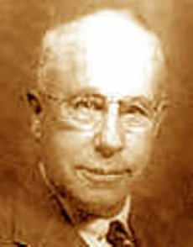
CHESTER BARNARD
“Success depends on the good relationship of managers and employees”

Slide 30
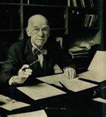
ELTON MAYO
DISCOVERED HUMAN MOTIVATION
THE HAWTHORNE EFFECT IS:
SATISFIED WORKERS = PRODUCTIVE WORKERS

Slide 31
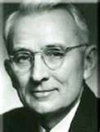
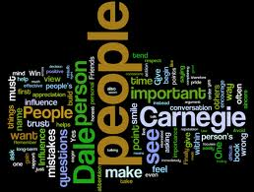
DALE CARNEGIE
“One’s success is achievable
only through winning the
cooperation of others”
Book:
“HOW TO WIN FRIENDS
AND INFLUENCE PEOPLE”

Slide 32
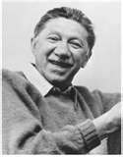
ABRAHAM MASLOW
MASLOW’S HIERARCHY OF NEEDS
SELF
ACTUALIZATION
SELF ESTEEM
SOCIAL
SAFETY
PHYSIOLOGICAL

Slide 33
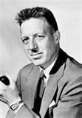
DOUGLAS MCGREGOR
THEORY X
Traditional management!
Workers are lazy
Material rewards
Must be controlled and threatened
Average human prefers to be directed
Dislikes responsibility
THEORY Y
Physical and mental effort in work is as natural as play or rest.
A man committed to aims of organization will work
If job is satisfying, man will commit to organization
Average man learns and seeks responsibility
Imagination, creativity and ingenuity can be used to solve work problems by employees
Modern industry utilizes only part of man’s intellectual potential

Slide 34
ORGANIZATIONAL BEHAVIOR (OB) A study concerned specifically with actions of people at work
FOCUSES ON TWO MAJOR AREAS:
INDIVIDUAL BEHAVIOR
FORMAL & INFORMAL GROUP BEHAVIOR

