Slide 1
Business communication
Lecture 3

Slide 2
WRITING PROCESS PHASE 1: PREWRITING
Lecture 3

Slide 3
BUSINESS WRITING IS:
PURPOSEFUL
solves problems/conveys info
PERSUASIVE
believable/acceptable message
ECONOMICAL
clear & concise
READER ORIENTED
concentrate on reader’s perspective

Slide 4
EXPRESS RATHER THAN IMPRESS!
The goal of business writing is to:

Slide 5
3 x 3 WRITING PROCESS
PREWRITING
ANALYZE
ANTICIPATE
ADAPT
WRITING
RESEARCH
ORGANIZE
COMPOSE
REVISE
REVISE
PROOFREAD
EVALUATE

Slide 6
3 x 3 WRITING PROCESS
PREWRITING
ANALYZE
ANTICIPATE
ADAPT
WRITING
RESEARCH
ORGANIZE
COMPOSE
REVISE
REVISE
PROOFREAD
EVALUATE

Slide 7
3x3 WRITING PROCESS: Phase One: PREWRITING
ANALYZE
IDENTIFYING THE PURPOSE
SELECTING THE BEST CHANNEL
ANTICIPATE
PROFILE AUDIENCE
RESPOND TO PROFILES
ADAPT
TONE –
REFLECTS HOW READER FEELS AFTER READING OR HEARING A MESSAGE!

Slide 8
ADAPTING TONE:
SPOTLIGHT AUDIENCE BENEFITS “empathy”
CULTIVATE “YOU” VIEW
USE BIAS-FREE LANGUAGE
BE CONVERSATIONAL BUT PROFESSIONAL
EXPRESS YOURSELF POSITIVELY
BE COURTEOUS
SIMPLIFY YOUR LANGUAGE
USE PRECISE, VIGOROUS WORDS

Slide 9
LEGAL & ETHICAL RESPONSIBILITIES
INVESTMENT INFORMATION
SAFETY INFORMATION
MARKETING INFORMATION
HUMAN RESOURCES INFORMATION
COPYRIGHT INFORMATION

Slide 10
ACTIVITY 4.1
CLASSWORK ASSIGNMENT

Slide 11
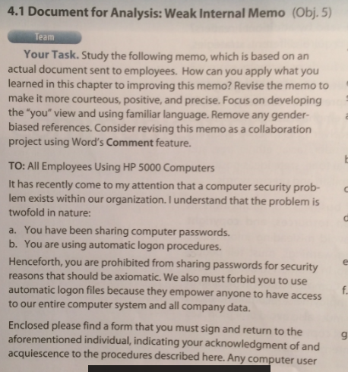

Slide 12
TO: All Employees Using HP 5000 Computers Your cooperation is urgently needed in solving a serious computer security problem. To enable you to keep your files and those of the entire company secure, please follow these two actions: 1. Keep your password private. Please do not share it with anyone. 2. Log on to the computer manually. Avoid using automatic log-on procedures.
By refusing to share your password, you prevent intrusion into your private files. Automatic log-on procedures are also dangerous. Although they seem to save time, they give anyone access to the entire computer system--even a person without prior knowledge of your password. Please sign the attached form and return it to me indicating that you are aware of this urgent problem and are willing to avoid these two actions in your computer use.

Slide 13
WRITING PROCESS PHASE 2: WRITING
Lecture #3

Slide 14
3 x 3 WRITING PROCESS
PREWRITING
ANALYZE
ANTICIPATE
ADAPT
WRITING
RESEARCH
ORGANIZE
COMPOSE
REVISE
REVISE
PROOFREAD
EVALUATE

Slide 15
3x3 WRITING PROCESS: Phase Two: WRITING
RESEARCH
FORMAL RESEARCH - INFORMAL RESEARCH
BRAINSTORMING/Mind Maps
ORGANIZE
LISTS & OUTLINES
PATTERNS: Direct & Indirect
COMPOSE
SENTENCES…EMPHASIS…PASSIVE/ACTIVE VOICE…PARAGRAPHS…LINKING… TRANSITIONS

Slide 16
3x3 WRITING PROCESS: Phase Two: WRITING
RESEARCH
ORGANIZE
COMPOSE
EFFECTVE SENTENCES
EMPHASIS
ACTIVE & PASSIVE VOICE
DANGLING & MISPLACED MODIFIERS
PARAGRAPHS: Direct Pivoting Indirect
BUILDING COHERENCE (Dovetailing)
TRANSITIONS

Slide 17
WRITING PROCESS PHASE 3: Revising
Lecture #3

Slide 18
3 x 3 WRITING PROCESS
PREWRITING
ANALYZE
ANTICIPATE
ADAPT
WRITING
RESEARCH
ORGANIZE
COMPOSE
REVISE
REVISE
PROOFREAD
EVALUATE

Slide 19
Phase Two: REVISING
REVISE
- FOR CLARITY
- FOR CONVERSATIONAL TONE
- FOR CONCISENESS
Remove Fillers
Delete Long Lead-ins
Eliminate Redundancies
Reduce Compound Prepositions
Purge Empty Words
- FOR VIGOR & DIRECTNESS
Kick the Noun Habit
Dump Trite Business Phrases
- FOR READABILITY
Develop Parallelism
Add Headings
Graphic Techniques
Measure Readability

Slide 20
Phase Two: REVISING
REVISE
- FOR CLARITY
- FOR CONVERSATIONAL TONE
- FOR CONCISENESS
- FOR VIGOR & DIRECTNESS
- REVISE FOR READABILITY
Develop Parallelism
Add Headings
Graphic Techniques
Dump Trite Business Phrases

Slide 21
3x3 WRITING PROCESS: Phase Two: REVISING
REVISE
PROOFREAD
SPELLING
GRAMMAR
PUNCTUATION
NAMES & NUMBERS
FORMAT
TECHNIQES – Proofreading marks, ect.
EVALUATE
Did it achieve your purpose? How do you know?

Slide 22
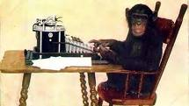
Write rough drafts of the following: Exercise 6.1 & 6.2
IN TEAMS OF 2:

