Slide 1
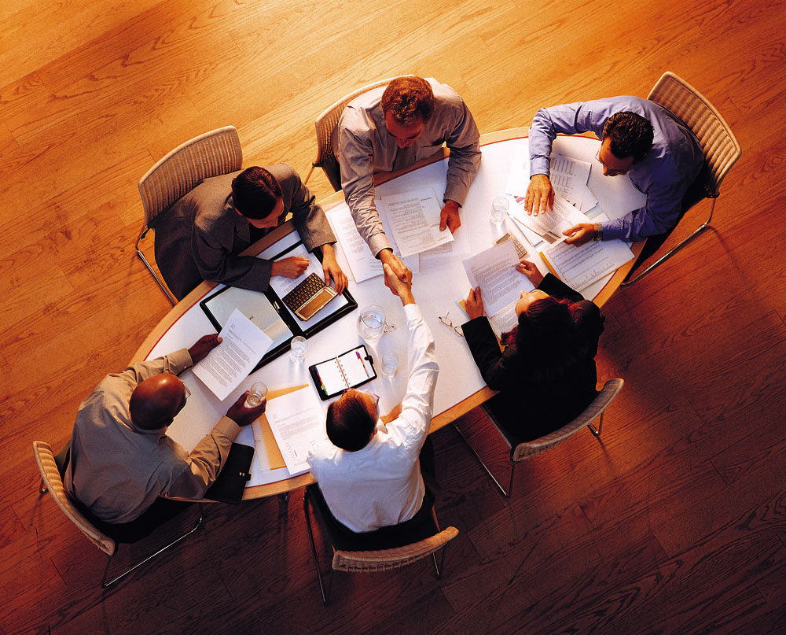
EFFECTIVELY FACILITATING MEETINGS

Slide 2
“If you had to identify, in one word, the reason the human race has not achieved, and never will achieve its full potential, that word would be “meetings”. Dave Berry

Slide 3
“If you cannot orchestrate a meeting, you are of little use to the corporation.”
Morris Schechtman, Leadership Trainer
“The inability to run effective meetings can torpedo a career.”
Wall Street Journal

Slide 4
CHARACTERISTICS OF SUCCESSFUL TEAMS
Size & Diverse makeup
Agreement on purpose
Agreement on procedures
Ability to confront conflict
Use of Good Communication
Ability to Collaborate rather than compete
Acceptance of Ethical Responsibilities
Shared Leadership

Slide 5
Planning & Conducting PRODUCTIVE MEETINGS:
Decide whether a meeting is necessary
Select the Needed Participants
Distribute Advance Information
Start the Meeting on Time
Move the Meeting Agenda Along
Participate Actively/Productively
Handle Conflict in Meetings
End the Meeting on Time and Follow up as Needed

Slide 6
Tools, Techniques, and Technology Used To Facilitate Collaboration:
Communication Tools
An Assigned ‘Scribe’
Voice Conferencing
Video Conferencing
Web Conferencing
Instant Messaging
Blogs
Wikis

Slide 7
Planning ‘SIMPLE’ Meetings:
S – Stage a meeting
I – Invite and inform the right people
M – Move the meeting agenda along
P – Preview & Review before/during & after
L – Listen, Listen, Listen
E – End the meeting with a plan

Slide 8
S.I.M.P.L.E.
S—MEET ONLY IF ABSOLUTELY NECESSARY!
Set an exact goal for each meeting.
Allocate time for each agenda item.
Schedule the meeting at the appropriate time of day
Ensure that the setting is correct.
Be Creative.
Know what decisions need to be made before, during and after the meeting?

Slide 9
S.I.M.P.L.E.
I—INVITE AND INFORM THE RIGHT PEOPLE
Invite only those who are needed for the meeting.
Inform participates of the agenda in advance
Allow preparation so they can bring completed information/research to the meeting.
Individually touch base with those you are counting on to lead any part of the agenda.

Slide 10
S.I.M.P.L.E.
M—MOVE THE MEETING ALONG
Move the meeting along from start to finish promptly.
Move the agenda along from item to item/monitor the time allowed for each part.
Move “off subject” items onto a “parking lot” list for another time.

Slide 11
S.I.M.P.L.E.
P—PREVIEW AND REVIEW before/during/after meetings
Preview agenda, time frame, and rules for discussion and decision making.
Preview summary at the end. Have each person (if reasonable) summarize meeting.
Request final input from each attendee.

Slide 12
S.I.M.P.L.E.
L—LISTEN, LISTEN, LISTEN
Listen to each other’s points of view
Listen to build on good ideas
Listen to all attendee input, understand what has been said, and then evaluate the ideas, discuss solutions, make decisions.
Listen to those who ask questions and keep the meeting moving forward.
Encourage participation

Slide 13
S.I.M.P.L.E.
E—END THE MEETING WITH A PLAN
End meeting with summary of what has been decided
Define items and ideas that need additional discussion or research
End meeting with a future plan:
Schedule the next meeting if needed.
Confirm attendee availability.
Provide “minutes” will be e-mailed promptly.

Slide 14
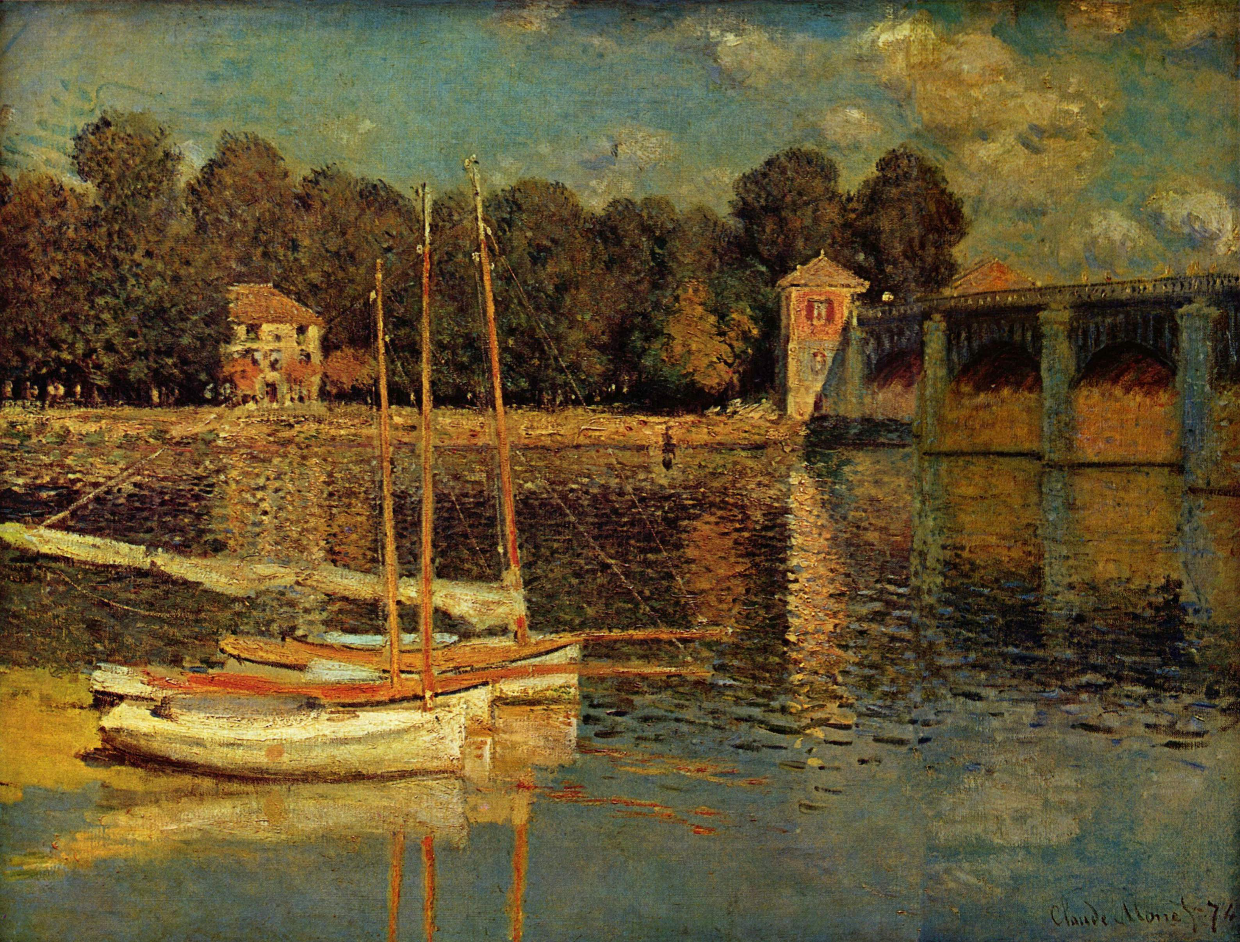
Now this looks like simplicity!

