Slide 1
Business communication
Lecture One

Slide 2
COMMUNICATION
The transmission of
information and meaning
from one individual or
group to another.

Slide 3
TOP SKILL SETS:
WHAT EXECUTIVES ARE LOOKING FOR:
TEAMWORK SKILLS
CRITICAL THINKING
ANALYTICAL REASONING SKILLS
ORAL COMMUNICATION SKILLS
WRITTEN COMMUNICATION SKILLS

Slide 4
KNOWLEDGE WORKERS IN THE INFORMATION AGE
KNOWLEDGE WORKERS –
GENERATE, PROCESS & EXCHANGE INFORMATION!
CRITICAL THINKING/PROBLEM SOLVING & DECISION
MAKING TECHNIQUES:
Identify the problem
Gather information
Evaluate the evidence
Consider alternatives and implications
Choose the best alternative and test it.

Slide 5
COMMUNICATION SKILLS
READING
LISTENING
NONVERBAL
SPEAKING
WRITING SKILLS
You control how well you communicate!

Slide 6
COMMUNICATION CYCLE
NOISE
ENCODING

Slide 7
DEFINITIONS
ENCODING – Converting an idea into words or gestures that convey meaning.
DECODING – translating the message from symbol form into meaning.
NOISE - Anything that interferes with the communication process.

Slide 8
COMMUNICATION CYCLE

Slide 9
FACTOR’S AFFECTING YOU IN TODAY’S WORKPLACE!
HEIGHTENED GLOBAL COMPETITION
FLATTENED MANAGEMENT HIERARCHIES
TEAM-BASED MANAGEMENT
COMMUNICATION TECHNOLOGIES
NEW WORK ENVIRONMENTS
DIVERSE WORKFORCE

Slide 10
COMMUNICATION TECHNOLOGIES
Internet
Facebook
Icloud
VoIP
Intranet
Voice recognition
Blogs, Podcasts, Wikis & Tweets
Web Conferencing
Voice Conferencing
Video Conferencing
Video Phone

Slide 11
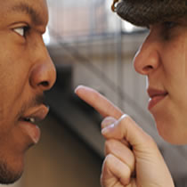
OBSTACLES THAT CAUSE MISUNDERSTANDING:
BYPASSING-
DIFFERING FRAMES OF REFERENCES-
LACK OF LANGUAGE SKILLS-
DISTRACTIONS-
Notes:
BYPASSING-
when people miss each other with
their meaning.
DIFFERING FRAMES OF REFERENCES-
formed by individual’s experience, education, culture, expectations, personality, etc.
LACK OF LANGUAGE SKILLS-
vocabulary, punctuation, grammar, written and oral expression…poor listening skills.
DISTRACTIONS-
emotional interference physical distractions & digital interruptions.

Slide 12
ELEVATOR SPEECH

Slide 13
RESEARCH FOR ELEVATOR SPEECH WHAT ARE YOU KEY STRENGTHS? 1. 2. 3. WHAT IS YOUR MOST UNIQUE SELLING POINT? _______________________________________________ WHAT ADJECTIVES DESCRIBE YOU? _______________________________________________________________________ WHAT PROBLEM WOULD YOU SOLVE IN THE WORKPLACE? ______________________________________________________________________ WHAT SHOULD THE LISTENER KNOW WHEN YOU FINISH? 1. 2. 3.

Slide 14
ELEVATOR SPEECH SHOULD: - SOUND CONVERSATIONAL - 30 SECONDS – NO MORE THAN 90 WORDS IN LENGTH - ENGAGE YOUR AUDIENCE BY ASKING OPEN ENDED QUESTION - KEEP YOUR SPEECH INTERESTING, MEMORABLE AND SUCCINCT - HAVE BUSINESS CARD WITH YOU

Slide 15
FINALIZE YOUR SPEECH: Write a sentence from each note you made Connect each sentence with additional phrases to make them flow Change any long words/jargon into everyday language Cut out unnecessary words Finalize speech to be sure it is no longer than 90 words.

Slide 16
THREE FORMAL CHANNELS:
DOWNWARD
UPWARD
HORIZONTAL
ONE INFORMAL CHANNEL:
GRAPEVINE

Slide 17
COMMUNICATING IN ORGANIZATIONS
INTERNAL COMMUNICATION
Procedures & polices, progress updates, develop new products & services, persuading employees & management to make changes, coordinating activities, evaluating employees.
EXTERNAL COMMUNICATION
Answering inquiries about products/services, persuading customers, clarifying supplier specifications, issuing credit, collecting bills, responding to government agencies, promoting a positive image of the organization.

Slide 18
THREE BUSINESS COMMUNICATION FUNCTIONS:
INFORM
PERSUADE
PROMOTE GOODWILL

Slide 19
TWO BASIC FORMS OF COMMUNICATION: ORAL & WRITTEN
ORAL COMMUNICATION:
ADVANTAGES DISADVANTAGES
Minimizes misunderstandings No documentation
Facial expressions Wastes time
Voice inflections Inconvenient
Develops consensus
Promotes friendships

Slide 20
TWO BASIC FORMS OF COMMUNICATION: ORAL & WRITTEN
WRITTEN COMMUNICATION:
ADVANTAGES DISADVANTAGES
Documentation Careful preparation
Time to develop/organize message Difficult to prepare
Prepared when convenient

Slide 21
ETHICS!
7 GOALS OF ETHICAL BUSINESS COMMUNICATORS:
1. Abide by the Law
2. Tell the truth
3. Label opinions
4. Be objective
5. Communicate Clearly
6. Use inclusive language
7. Give Credit

Slide 22
WRITING SKILLS???
GRAMMAR PUNCTUATION SPELLING

Slide 23
WHAT EMPLOYERS ARE LOOKING FOR:
EDUCATION
EXPERIENCE
HARD SKILLS (Technical)
SOFT SKILLS:
Oral communication
Written communication
Listening
Non-verbal
Interpersonal
Team players
Problem solving
Decision making
Adapting to change
Implementing change
Organizational
Leadership

Slide 24
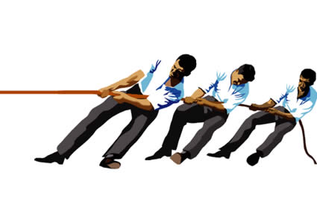
WHY FORM GROUPS & TEAMS?
Better decisions
Faster response
Reduced risks
Greater “buy-in”
Increased productivity
Less resistance to change
Improved employee morale

Slide 25
4 PHASES OF TEAM DEVELOPMENT
FORMING
STORMING
NORMING
PERFORMING

Slide 26
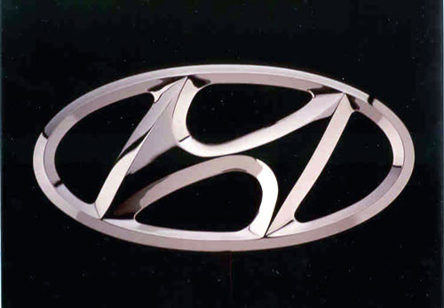
VIRTUAL TEAMS – shared purpose across space, time and organization boundaries using technology.
HYUNDIA MOTORS
Engineering in Korea
Research ion Tokyo/Germany
Styling in California
Engine calibration/testing in Michigan
Heat testing in California desert

